Slide 1
NN Techniques in KBQA: A Brief Introduction
Kangqi Luo
2017/11/15

Slide 2
Contents
KBQA Introduction
Task & Dataset
Framework
Candidate Generation
Relation Detection
Re-Rank Trick
Experiments
Conclusion

Slide 3
Contents
KBQA Introduction
Task & Dataset
Framework
Candidate Generation
Relation Detection
Re-Rank Trick
Experiments
Conclusion

Slide 4
KBQA Introduction
Question Answering over Knowledge Bases
Focus on factoid questions
The answer is a single entity in the KB
“ what is the name of justin bieber brother ? ”
Answer: “Jazmyn Bieber” “Jaxon Bieber”
Structure:
Justin Bieber
sibling relationship
siblings
Notes:
What we really care is the semantic structure behind the direct answer.

Slide 5
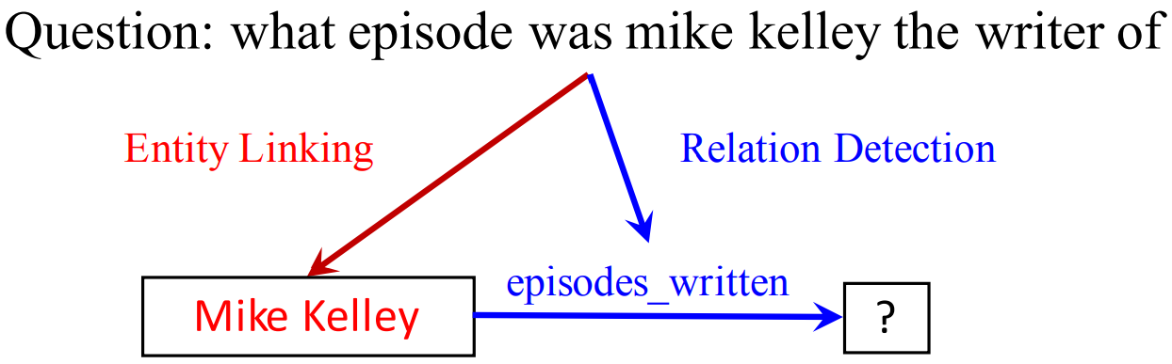
Query Structure

Slide 6
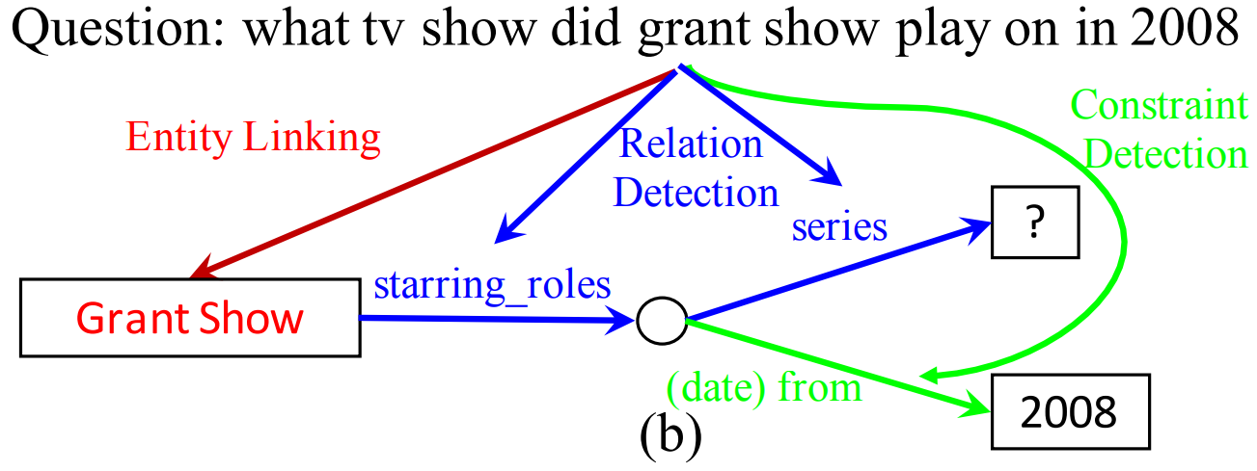
Query Structure

Slide 7
KBQA Datasets
WebQuestions [Berant et al., 2013]
5810 QA pairs
SimpleQuestions [Bordes et al., 2015]
100K+ <question, focus entity, relation> triples
Simple semantics
ComplexQuestions [Bao et al., 2016]
2100 QA pairs
Answer is derived from multiple constraints
Checkout in Galaxy & Blackhole
/home/data/…
Notes:
focus on SimpleQuestions

Slide 8
Contents
KBQA Introduction
Task & Dataset
Framework
Candidate Generation
Relation Detection
Re-Rank Trick
Experiments
Conclusion

Slide 9
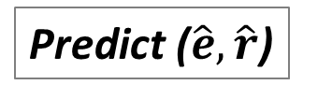
KBQA Framework
Candidate Generation
{(e, r)} candidates
linking s(q, e)
Question
Relation
Detection
Entity
Re-Rank
Predict ($\hat{e},\hat{r}$)
mapping score s(q, r)
Notes:
based on the two score (sum, or …)

Slide 10
KBQA Framework
Candidate Generation
{(e, r)} candidates
linking s(q, e)
Question
Relation
Detection
Entity
Re-Rank
Predict ($\hat{e},\hat{r}$)
mapping score s(q, r)

Slide 11
Candidate Generation
“ what is the name of justin bieber brother ? ”
mention
Candidate entity
parents
candidate
query structures
{(e, r)}
m.06w2sn5
Justin Bieber
album
sibling relationship
siblings
……
Notes:
Find out the candidate focus entities in the question.
The potential query structures start from the focus.

Slide 12
Candidate Generation
“ where is rome italy located on a map ? ”
Generate candidates
Calculate entity linking score
m.06c62
Rome
m.03rjj
Italy
m.06k176
Rome (TV series)
m.0218mm
Italian Peninsula
……
……
……

Slide 13
Candidate Generation
External Module
Lexical Overlap Score [Yin et al., 2016]
SMART [Yang and Chang, 2015]
BiLSTM-CRF [Dai et al., 2016] [Yin et al., 2016]
Internal Module
Surface based approach for generating candidates
Learn the score through entity linking model
Notes:
SMART: GBDT
treat as a hyper parameter
longest consecutive common subsequence
always keep top-k

Slide 14
Candidate Generation
Surface based approach [Golub and He, 2016]
Take all entities whose English name is a substring of Q
Remove entities whose name is a substring of another entity (longest match)
Keep top entities by popularity (number of related facts)
Fuzzy match (optional): edit distance <= 1
[Lukovnikov et al., 2017]

Slide 15
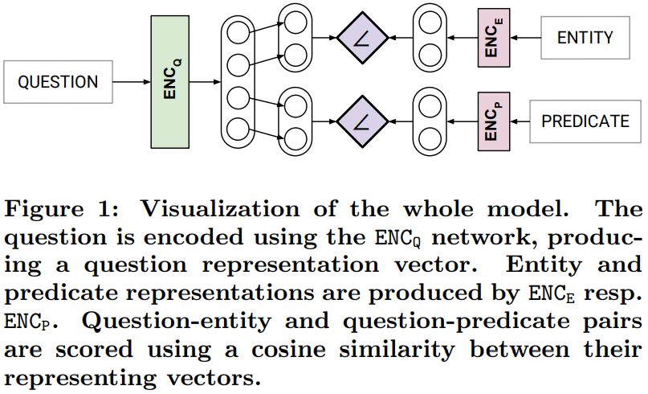
Entity Linking Module
Lukovnikov et al. [2017]
Notes:
Lukovnikov as running example

Slide 16
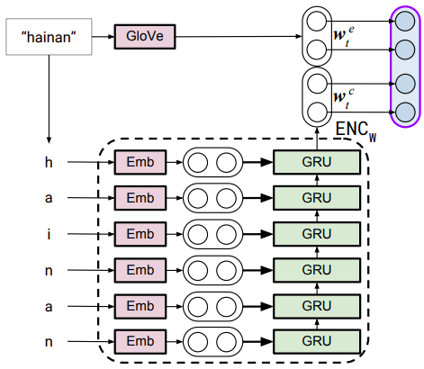
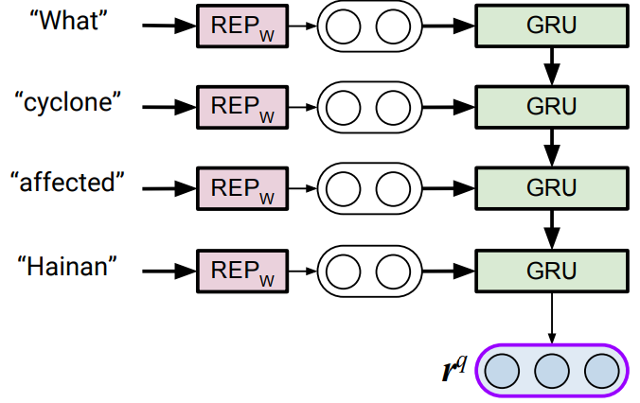
Entity Linking Module
Sentence encoding: word and char level GRU

Slide 17
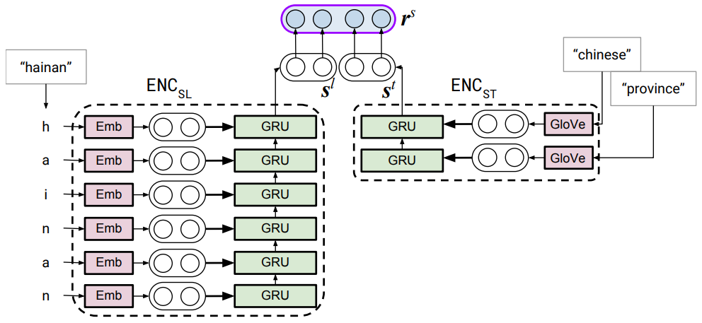
Entity Linking Module
Entity Encoding
Char level GRU + entity type information
Notes:
Surprisingly good
but I thought: some disturbing??
no bidirectional, and seems a bit casual

Slide 18
KBQA Framework
Candidate Generation
{(e, r)} candidates
linking s(q, e)
Question
Relation
Detection
Entity
Re-Rank
Predict ($\hat{e},\hat{r}$)
mapping score s(q, r)

Slide 19
Relation Detection
Intuition: Calculate the similarity between the question and candidate predicate.
cosine
hidden
vector
NN
NN
what episode was <e> the writer of
episodes_written
Question Surface
Predicate Sequence (Canonical Name)

Slide 20
Relation Detection: RNN
Lukovnikov et al. [2017]
Notes:
Lukovnikov as running example

Slide 21
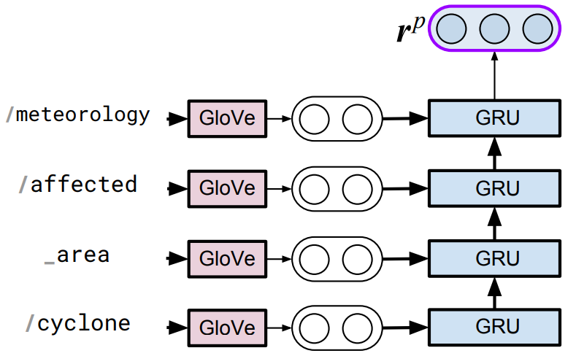
Relation Detection: RNN
Predicate Encoding
Taking predicate id as input
Notes:
a bit casual, not uniformed
why GRU, no bidirectional GRU
attention is never discussed or compared
RNN then split,

Slide 22
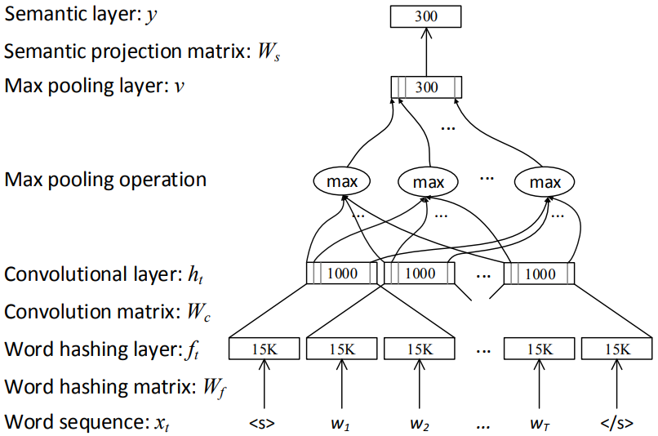
Relation Detection: CNN
CNN Model [Yih et al., 2015] [Bao et al., 2016]
Siamese
Word Hash
Notes:
word hashing technique

Slide 23
Relation Detection: CNN+Att.
Attentive CNN [Yih et al., 2016]
Most predicates consist of a few words
Questions are highly variable in length and word choices
Attention are guided by the predicate over N-gram phrases
Phrases more similar to the predicate, will be selected with higher probability than other phrases to represent the question.

Slide 24
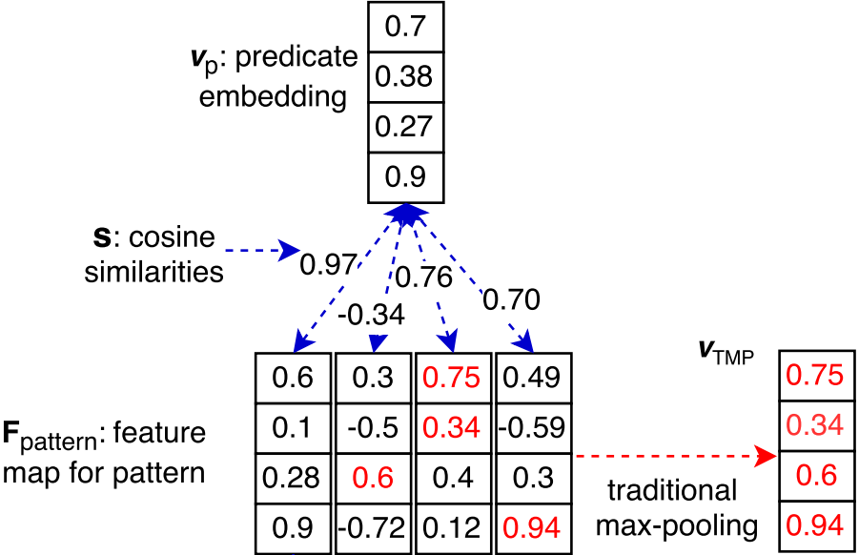
Relation Detection: CNN+Att.
Notes:
Why work? The predicate serves as the sub component of the question (not equal)
Wrong predicates tend to be far away from any part of the question

Slide 25
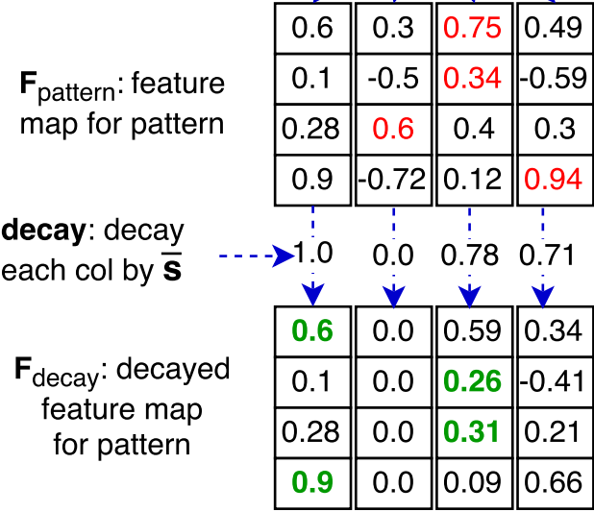
Relation Detection: CNN+Att.

Slide 26
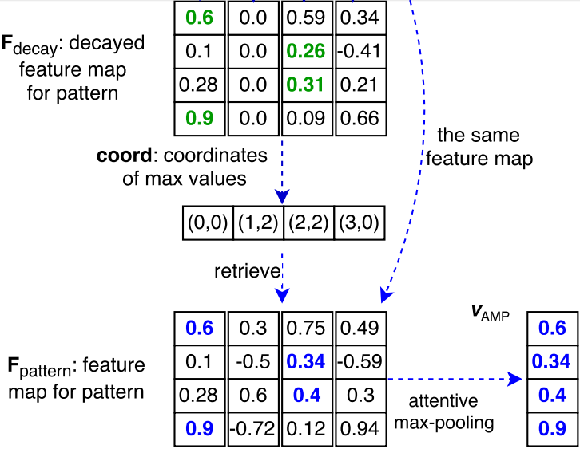
Relation Detection: CNN+Att.

Slide 27
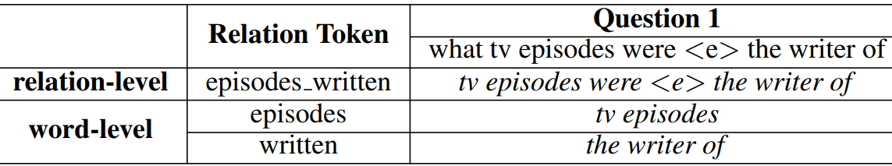
Relation Detection: Residual RNN
RNN with different granularity [Yu et al., 2017]

Slide 28
Relation Detection : Residual RNN
Relation as word sequence (word level)
“what tv episode is written by <e>” → “episodes, written”
Better generalization in training
Missing global information of the relation, especially when the question and the correct predicate doesn’t match in word level.
Relation name as a single token (relation level)
“what did <e> do” → profession
Captures the global association between them.
Suffers from the generalization due to limited amount of data

Slide 29
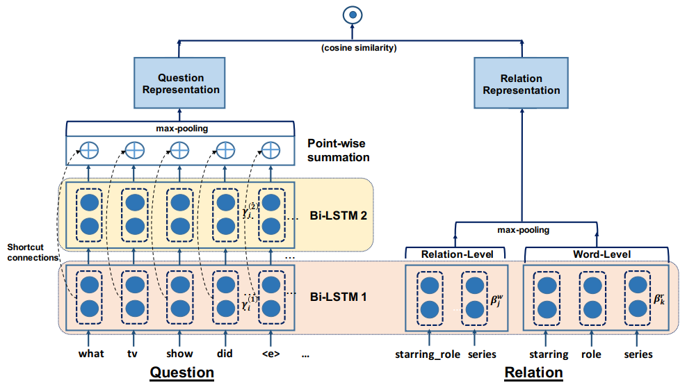
Relation Detection : Residual RNN

Slide 30
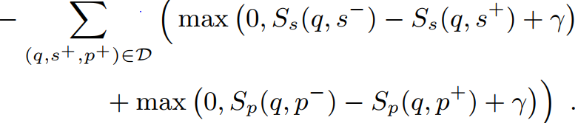
Model Training
Hinge Loss (ground truth is directly provided)
Lukovnikov et al. [2017]
Yu et al. [2017]
Negative Sampling
corrupt entities / relations from the candidate pool

Slide 31
KBQA Framework
Candidate Generation
{(e, r)} candidates
linking s(q, e)
Question
Relation
Detection
Entity
Re-Rank
Predict ($\hat{e},\hat{r}$)
mapping score s(q, r)

Slide 32
Entity Re-Rank in Prediction
Traditional: entity linking score and relation detection score are independent of each other.
Re-rank: Relation detection provides a feedback.
Raise the linking score of an entity, if some of its surrounding predicates are highly associated with Q.

Slide 33
Entity Re-Rank in Prediction
Ex: “ what episode was mike kelley the writer of ? ”
Mike Kelley (TV writer)
profession author_of episodes_written
Mike Kelley (Basketball Player)
profession teams player_statistics
Prefer the first entity after re-rank.

Slide 34
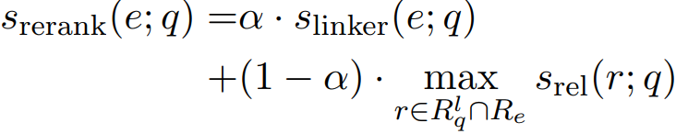
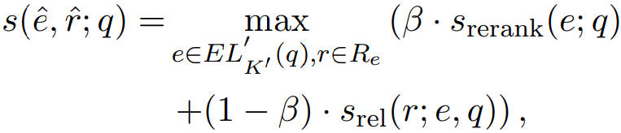
Entity Re-Rank in Prediction
Re-rank in Yu et al. [2017]

Slide 35
Quiz
Lots of mention words in the test question set are never observed in the training set, this problem is called OOV (out-of-vocabulary).
Which of the following techniques attempt to handle this problem? (Multiple Choices)
A. pre-trained word embedding
B. attention guided by the predicate over question N-gram
C. char-level RNN
D. word hashing

Slide 36
Contents
KBQA Introduction
Task & Dataset
Framework
Candidate Generation
Relation Detection
Re-Rank Trick
Experiments
Conclusion

Slide 37
Experimental Results
End-to-End Results
Work | SimpQ (Acc) | WebQ (F1) | CompQ (F1) | Note
Yih et al., 2015 | 72.8 | 52.5 | NA | SMART Linker
Bao et al., 2016 | NA | 52.4 | 40.9 | SMART Linker
Yin et al., 2016 | 68.3 | NA | NA
Yin et al., 2016 | 76.4 | NA | NA | BiLSTM-CRF Linker
Golub and He, 2016 | 70.9 | NA | NA
Lukovnikov et al., 2017 | 71.2 | NA | NA
Yu et al., 2017 | 77.0 | NA | NA | SMART Linker

Slide 38
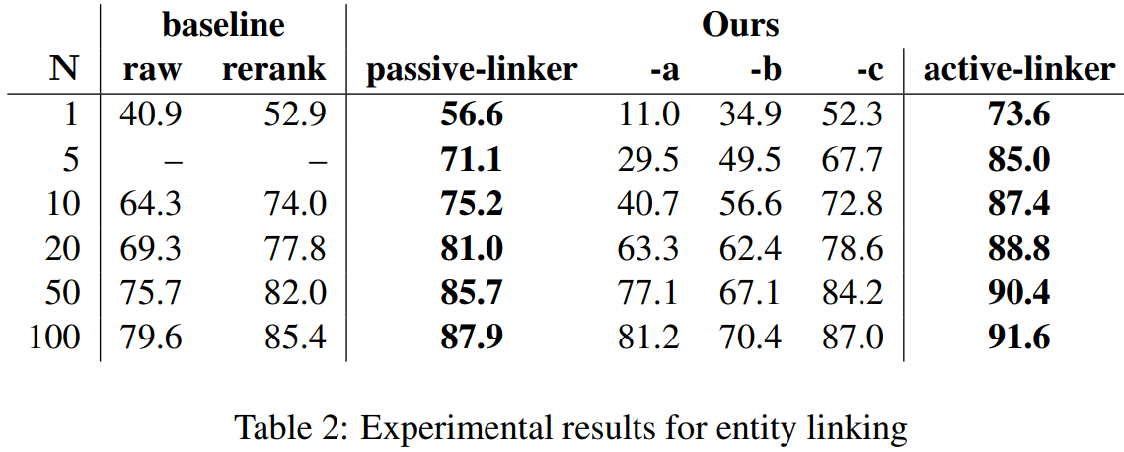
Experimental Results
Entity Linking [Yin et al., 2016]

Slide 39
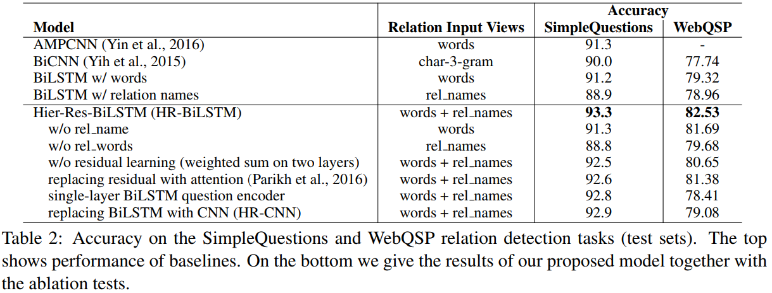
Experimental Results
Relation Detection [Yu et al., 2017]
Notes:
the improvements are limited

Slide 40
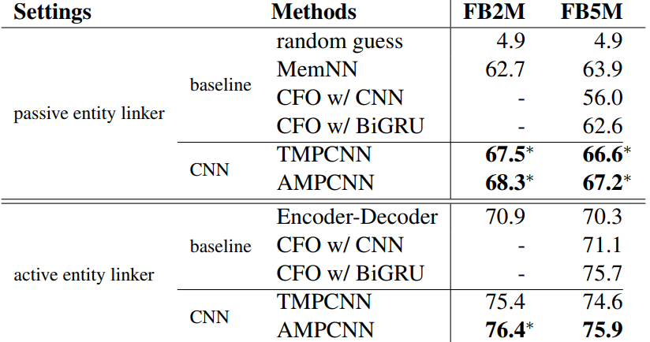
Experimental Results
CNN with / without Attention [Yin et al., 2016]
Notes:
the improvements are limited

Slide 41
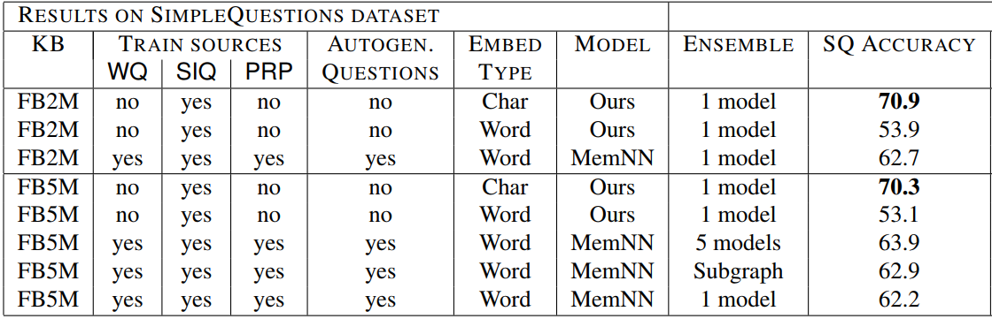
Experimental Results
Char-level Encoding [Golub and He, 2016]

Slide 42
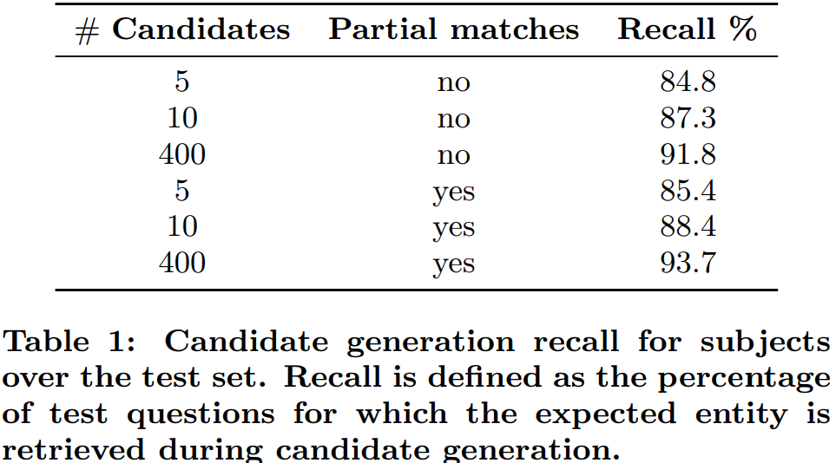
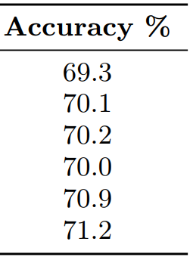
Experimental Results
Entity Re-Rank [Lukovnikov et al., 2017]

Slide 43
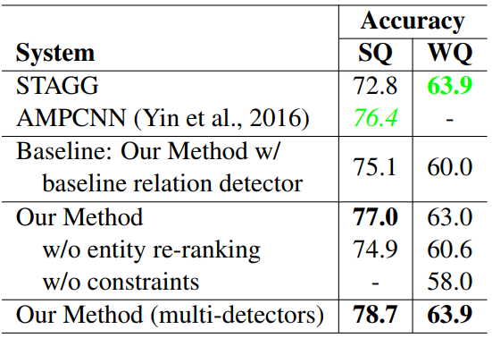
Experimental Results
Entity Re-Rank [Yu et al., 2017]

Slide 44
Conclusion
SimpleQuestions is more valuable
Large size, annotated focus entity + relation
Always conduct detail experiments
Entity linking only, relation detection only
Attention mechanism improves the performance
But just a slight improvement
Pay more attention to tricks in the model
Char-level RNN, entity re-rank

Slide 45
References
[Bao et al., 2016] Constraint-Based Question Answering with Knowledge Graph. COLING 2016.
[Berant et al., 2013] Semantic Parsing on Freebase From Question Answer Pairs. EMNLP 2013.
[Bordes et al., 2015] Large-scale simple question answering with memory networks. Arxiv 2015.
[Dai et al., 2016] CFO: Conditional Focused Neural Question Answering with Large-Scale Knowledge Bases. ACL 2016.
[Golub and He 2016] Character-level question answering with attention. EMNLP 2016.

Slide 46
References
[Lukovnikov et al., 2016] Neural Network-based Question Answering over Knowledge Graphs on Word and Character Level. WWW 2017.
[Yih et al., 2015] Semantic Parsing via Staged Query Graph Generation: Question Answering with Knowledge Base. ACL 2015.
[Yih et al., 2016] Simple Question Answering by Attentive Convolutional Neural Network. COLING 2016.
[Yu et al., 2017] Improved Neural Relation Detection for Knowledge Base Question Answering. TACL 2017.
[Yang and Chang, 2015] S-MART: Novel tree-based structured learning algorithms applied to tweet entity linking. ACL 2015.

Slide 47
thanks for your TIME!

